Slide 1




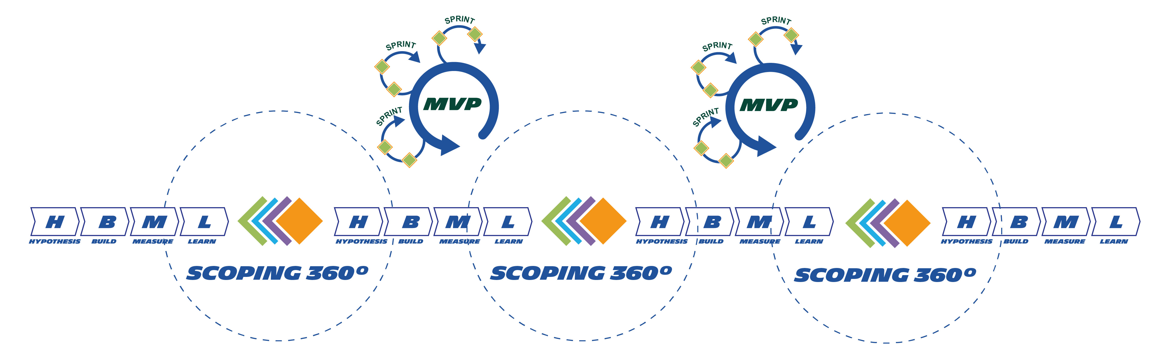
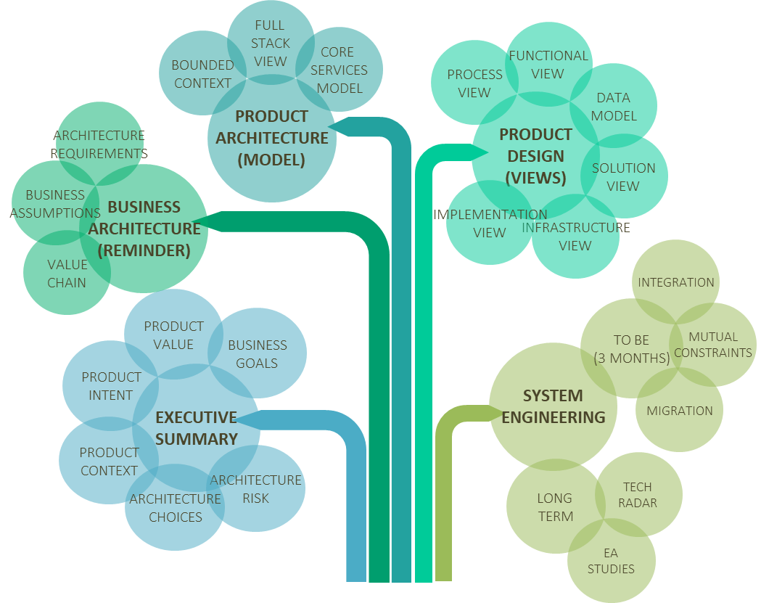
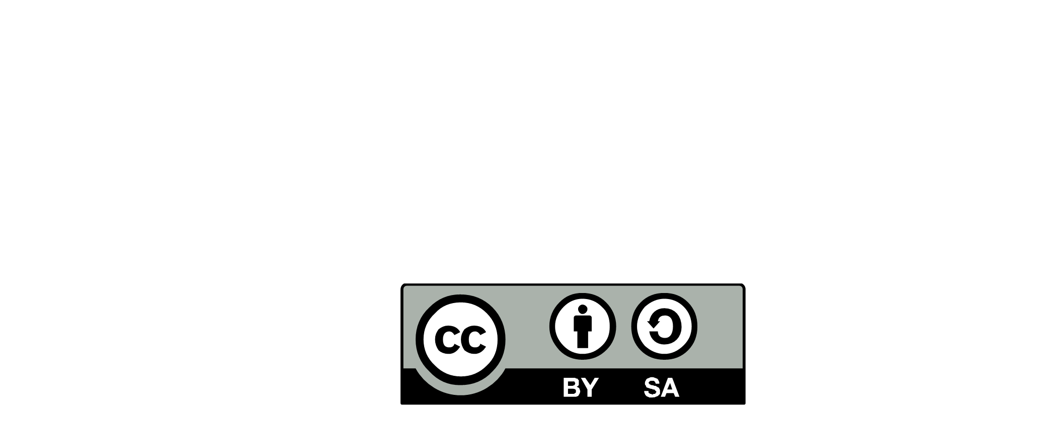

CONTINUOUS
ARCHITECTURE
Enterprise
& Portfolio
ARCHITECTURE DECISION
BOARD
GITLAB
DECISION
LOG
Architecture
Community
EA STEERING
GLOBAL
TECHNICAL
DEBT
DECOM. ROADMAP
ARCHITECTURE
RISK
TRANSVERSAL
ARCHITECTURE
TOPICS
PSQ /PSV
PROJECT
PORTFOLIO
IS BALANCE
SCORECARD
MODEL
Kit
IS PORTFOLIO
IS PORTFOLIO
IT CAPABILITIES
ROADMAP
IT STRATEGY
ARCHITECTURE
MODELS
ARCHIMATE
APPLICATION
ANALYTICS
APPLICATION
PORTFOLIO
ARCHITECTURE
COMMUNITY
SEMINAR -EVENT
FUNCTIONAL DOMAIN(S)
ROADMAP
BUSINESS
AMBITIONS
WEEKLY
ARCHITECTURE
WORKSHOP
EA STEERING
SITE
REFERENCE ARCHITECTURE (In-sourcing)
Client - Market
Kit
DEMO
FUNCTIONAL
ISSUE
LOCAL
TECHNICAL
DEBT
CO DESIGN
VALIDATION
DEPLOYEMENT
MASTER PLAN
GITLAB
DECISION
LOG
TECHNICAL
ISSUE
PRINCIPLES
GREEN
PATTERNS
GUIDELINES
BLUEPRINT
MICHELIN
CAPABILITIES
Kit
EA STUDIES
BACKLOG
Kit
IMPACT MAPPING
ARCHITECTURE
RUNWAY
PEER
REVIEW
VALUE
CHAIN
EA STUDIES
Kit
USER RESEARCH
DEMO
DOMAIN
DRIVEN
DESIGN
IT COMPONENT
CATALOG
Kit
VALUE
PROPOSITION CANVAS
EA
STEERING*
PEER REVIEW
Kit
Kit
USER
STORY
Kit
EA STUDY
SCOPING 360°
EVENT
STORMING
ARCHITECTURE
EVENT
(EXT. / INT.)
PROBLEM
SOLVING
ARCHITECTURE
STUDIES
ARCHITECTURE
PROBLEM SOLVING
INCIDENT
PROBLEM SOLVING
ARCHITECTURE PROBLEM
SOLVING
TECHNOLOGY
KNOWLEDGE
(RADAR)
Kit
LEARNING
ARCHITECTURE
ARCHITECTURE
RETROSPECTIVES
INCIDENT
REVIEW
Kit
PLATFORMS
AS A SERVICE
IT Platforms
Providers
MVP
(MININUM VALUABLE PRODUCT)
TEAM
SKILLS
LEGEND
Kit
TEAM ORGANISATION
CONSOLIDATED BACKLOG
-FEATURES
-ENABLERS
Kit
AGILE ROADMAPING
CONTINOUS
ARCHITECTURE
DELIVERABLE
IT CAPABILITY LAB
Kit
ARCHITECTURE SPIKES
TEST CARD
LEARNING
EVENT
Domain-
Program
DEVOPS
PRACTICES
ARCHITECTURE ROLE
& RESPONSABILITIES
TECHNOLOGICAL EVENT (EXT. INT.)
ARCHITECTURE RITUALS
Kit
CONTINOUS
ARCHITECTURE
PRINCIPLES
FMEA
ARCHITECTURE
COACHING
ARCHITECTURE BOARD
ARCHITECTURE
RETROSPECTIVES
DEEP
DIVE
EXPERTISE
MOBISATION
Kit
FITNESS
FUNCTION
ARCHITECTURE
STAFFING
GLOBAL
SKILLS
Sécurité
UX
Specialiost
Kit
ARCHITECTURE KIT
SERVICE
NOW
ARCHITECTURE
KATA
ARCHITECTURE DELIVERABLES
RCA /PROBLEM
SOLVING
ARCHITECTURE
ACADEMY
TECH LUNCH
ARCHITECTURE TOOL
INCIDENTS
TECH
SKILLS
Kit
INCIDENT
REVIEW
CoP (Communities Of Practices)
Learning
Architecture
FRACAS
TRAINING & SUPPORT
Run
OPERATING MODEL -2020.2 -
DESIGNED BY :

